Slide 1
PANACEA
A one-stop instant solution to all your medical problems

Slide 2
PROBLEM
Hey! I am Jordan.
I work in an MnC in Bangalore and live alone away from my family.
I have a headache and muscle ache since yesterday. I am also feeling unusually lethargic and nauseatic and my body temperature has risen to 103°C.
I have also had a history of some antibody deficiency.
I have no idea which medicine shall I take to get a relief. Neither do I have any one else to take care of me nor do I have the energy to go the doctor!

Slide 3

PROBLEM
People living alone away from their families are not able to get medical consultation easily.
Time Consumption : People have to wait in long queues for hours despite of being unwell.
Cost-Inefficiency : Visiting a doctor adds additional transportation & operational costs as well.

Slide 4
HERE COMES PANACEA !
BEFORE
AFTER
Escalating health problems due to lack of timely consultation from the experts.
Hectic work schedules cause hypertension which can result in obesity, depression and heart diseases, etc.
Decreasing immunity due to inadequate health checkups.
Expert advice is provided at the comfort of the patients home.
Regular health tracking will help the individual to regulate his/her lifestyle in order to remain healthy.
Quick and cost-efficient health check-ups will be facilitated.

Slide 5
SOLUTION
PANACEA is a web application based on ML model for predicting the type of disease based on the symptoms provided by
Patient Experience
Scan Reports
X-Rays
Medical History
Based on the prediction, a list of medicine will be displayed along with the suggestions of nearby medical stores where the patient can buy the medicines from.
Based on the nature of the disease the application will give recommendation for preventive measures and the nearest hospitals
All this with just a click from anywhere within seconds!
In case of serious diseases, the patient will not be given any instant medicines and will rather be directed for a consultation with the expert. This will be done keeping in mind the safety of the patients.

Slide 6
SWOT ANALYSIS
S
W
O
T
STRENGTHS
WEAKNESSES
Patients can create their own profiles on this app.
Complete record of the medical history will be maintained.
No name in the market yet.
No established associations with major hospitals.
OPPORTUNITIES
THREATS
To collaborate with more hospitals and service providers.
People are becoming more reliable on internet.
Instant solutions are being preferred nowadays.
Improve the doctor & patient ratio
Already existing competitors in the market.
Lack of funding

Slide 7
PRODUCT OVERVIEW
Make your own profile
Book an appointment with the expert
This will help a person to keep his/her medical history intact and safe for prolonged periods.
Appropriate medicines will be suggested accordingly.
Find out your heart health
X-Ray Scans

Slide 8
OUR PLANS
PRO
PREMIUM
Web
Medicine Reminder
Doctor consulting (Once a month)
Web Service
Reminder for medicine
BASIC
Web Service

Slide 9
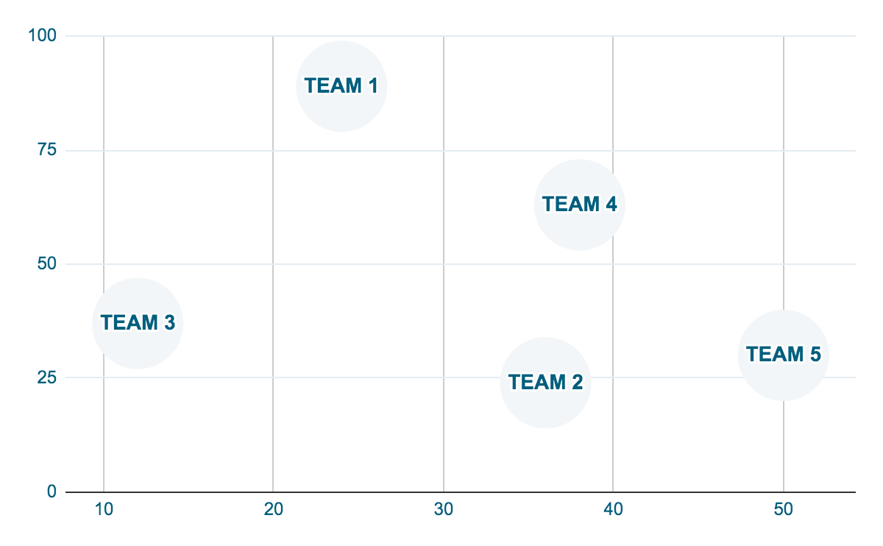
TRACTION
50,000
PRO USERS
390,000
QUERIES
250,000
MOBILES

Slide 10
REVIEWS
JOHN SMITH
(Patient, registered at PANACEA)
This app has definitely bridged the gap between the doctors & patients. I have had a wonderful experience since this app allows me to keep a regular track of my health and helps me to stay fit!
Jane Cordero
(Patient, registered at PANACEA)
I have earlier gone through a heart surgery. Through this app, I can even have a track on my heart rate & receive alerts if there seems something wrong.

Slide 11
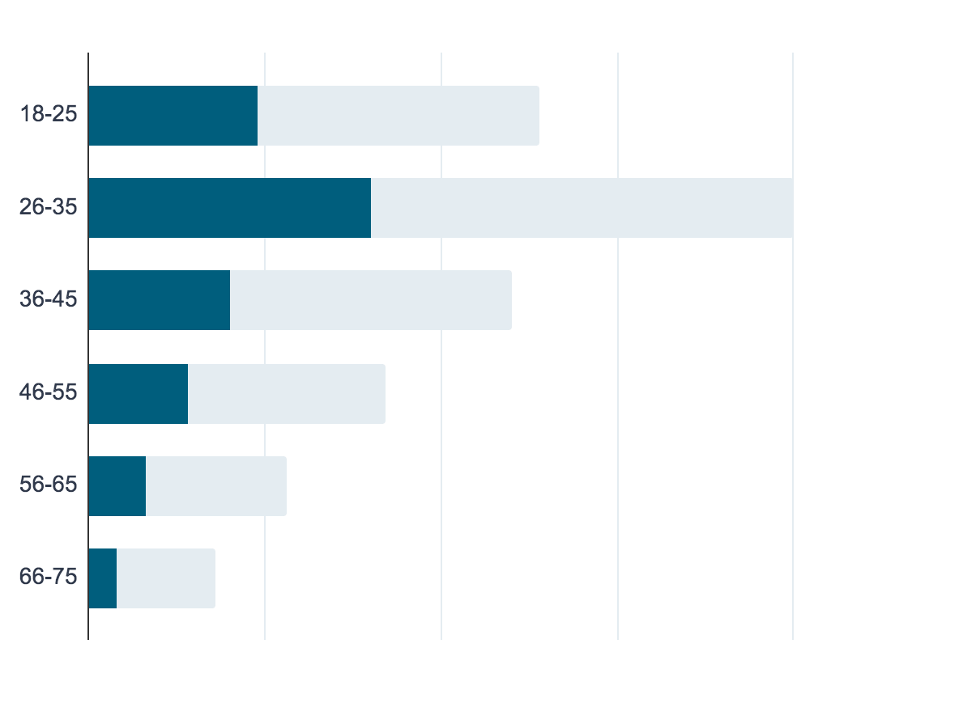
TARGET
AGE
TARGETED USERS
50,000

Slide 12
COMPETITORS
 | Name
COMPETITOR 1 | Roam Analytics
COMPETITOR 2 | Sopris Health
COMPETITOR 3 | Artelus

Slide 13
OUR TEAM
Manan Tayal
Francis Jaya Suriya
K. Sudheeradh
Somya Singh
Rajat Bhai

Slide 14
THANKS

